Slide 1


Ayushman Elder Care Services
Office Address – Baghajatin Station Road, Near Indian Bank, Jadavpur, Kolkata
Registered Address –Narendrapur Station Road , Near IHRM Hotel Management College,Sonarpur,Kolkata

Slide 2
Our Services
Medical Exigency Support | Companionship
Legal Work | 24x7 Ambulance Service
Financial Management | Home ICU Setup
Remote family care consultancy | Physiotherapy
Regular touch programme | Home Care
Long term treatment support | Dementia Care
Remote logistical support | Home dental & Eye Checkup
Property management | Cancer treatment support
Special occasion celebration support | Dialysis treatment support
Ayushman Elder Care Services

Slide 3
Our Services | Details
Medical Exigency Support | Regular health monitoring with proper documentation. Medicines Supply. Emergency Support. Home ICU set up. Doctor visit as per requirement and on regular basis. 24x7 Ambulance services. Trained Nurse , Attendant & Physiotherapist. 24x7 Care manager’s call coordination.
Legal Work | Documents correction ( Mediclaim ,Adhar ,PAN , Legal support against Elder Abuse etc ).
Financial Management | Banking Support , Post Office Service , Utility Bill Payment , Insurance claim , Audit , Property .
Remote family care consultancy | Blood and other tests and few diagnosis ,

Slide 4
Our Services | Details
Regular touch program | Five types of membership plans , Scheduled Dedicated Care Manager’s visit ,
Long term treatment support | Medical equipment on rent ,Home assistant support , Home Care
Property management | Corporation , Municipality related support, Renovations, Interior decoration
Special occasion support | Birthday , Anniversary and other occasion support
Dementia Care | Mental activity practice , re-memorisation practice ,extensive companionship ,Walking assistance , Counselling , Indoor Games , Cognitive Rehab Practice at Home , Occupational Therapy

Slide 5
Our Services | Details
Companionship | Motivation Mental Stimulation Spending quality time Emotional Support Social Interaction Focusing on reducing loneliness and improving quality of life through activities like conversation ,sharing meals, hobbies, running errands(shopping , attending events and appointments). Simply being a trusted friend to keep seniors engaged, safe and connected
24x7 Ambulance Service | Ambulance form different location all over Kolkata including ICU setup,oxygen,AC/NonAC,bookings for long time duration,attendents. We have 11 different ambulance booth.
Home ICU Setup | Essential medical equipment’s – Hospital/Fowler Bed and Air Mattress , Oxygen concentrator/cylinder , BiPAP C-PAP, Ventilator, Nebulizer , Suction Machine , IV Stand
Physiotherapy & Yoga | Male and female physiotherapist & yoga therapists.
Dementia Care | Palliative Support And Care at Home, Regular coordination with Doctor and Medical Team, Appointment Booking, Accompany during treatment and follow up, Emotional Support and addressing the need of patient, Managing side effects, Councilling and Therapy

Slide 6
Our Services | Details
Home dental & Eye Checkup | Basic Preventive and Routine checkup can be arranged, appointments can be scheduled of specialist doctors.
Cancer treatment support | Palliative Support And Care at Home, Regular Coordination with Doctor and Medical Team, Appointment Booking, Accompany During Treatment and follow up, Emotional Support and Addressing the Need of Patient, Managing side effects, Counselling and Therapy
Dialysis treatment support | Palliative Support And Care at Home, Regular Coordination with Doctor and Medical Team, Appointment Booking, Accompany During Treatment and follow up, Emotional Support and Addressing the Need of Patient, Managing side effects, Counselling and Therapy
Home renovation & Interior Design | Making Connection with Registered and experienced 3rd party service providers creating safe and Accessible Environment Assisting in making decisions and coordination with patron, Minimize Disruption and Ensure quality service

Slide 7
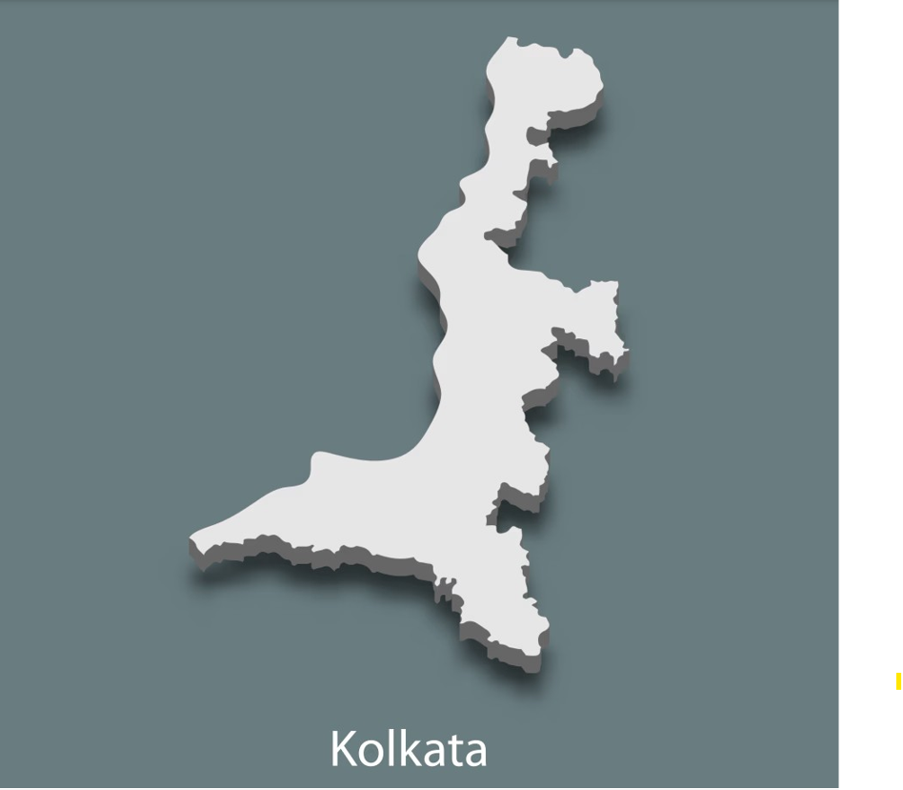
24x7 Ambulance Network | Location
Birati
Dumdum
Airport
Rajarhat
New town
Saltlake
Ultadanga
Shyambazar
Gariahat
Golf Green
Mukandapur
Tollygunge
Maheshtala
Batanagar
Behala

Slide 8
Motivation
Mental Stimulation
Recovering Support
Emotinal Support
Companionship
Reduction of loneliness
Engaging in Activities
Monitor Health and Safety
Being Trusted friend
Playing Indoor Games
Running Errands

Slide 9
MEMBERSHIP NAME | NO.OF VISIT(s) IN A MONTH | CHARGE(SINGLE/COUPLE) | YEARLY | QUARTERLY | NO.OF CALLS IN A WEEK | NIGHY EMERGENCY, HOLIDAYS,SUNDAYS
SEBA-BESIC | ONE | 999/1500 | 11000/17000 | 3000/4500 | WEEKLY ONCE | 500/hr
SURAKSHA-STANDARD | TWO | 1999/2499 | 23000/29000 | 6000/7500 | WEEKLY ONCE | 500/hr
SANJEEVANI-PREMIUM | FOUR(WEEKLY ONCE) | 4500/5000 | 52500/58500 | 13500/15000 | WEEKLY ONCE | 500/hr
AMRIT-ELITE | EIGHT(WEEKLY TWO) | 7000/8000 | 82000/94000 | 21000/24000 | WEEKLY ONCE | 500/hr
INDEPENDENT | NO VISITS | - | 6000/7000 | - | WEEKLY ONCE | 500/hr
Ayushman Elder Care Services

Slide 10
Membership Plan
SERVICES COVERED IN EACH VISIT | SEBA-BESIC | SURAKSHA-STANDARD | SANJEEVANI-PREMIUM | AMRIT-ELITE
Dedicated personal Buddy | Yes | Yes | Yes | Yes
Emergency Buddy Assistance 24X7 | Yes | Yes | Yes | Yes
Co-ordination with ambulance | Yes | Yes | Yes | Yes
Buddy Connect Call | Once in a week | Once in a week | Once in a week | Once in a week
Making Service Sheet and keeping all records | Yes | Yes | Yes | Yes
Utility Bill Payment | Yes(During visit) | Yes(During visit) | Yes(During visit) | Yes(During visit)
Salary/Wage management for home staffs | Yes(During visit) | Yes(During visit) | Yes(During visit) | Yes(During visit)
Passport office works, corporation office works, life certificate submission, govt. office works. Pension withdrawal from bank. Collection/deposit of Cheque/ Bills/ Cash etc. Delivery of Medicine | Yes (During Visit) | Yes (During Visit) | Yes (During Visit) | Yes (During Visit)
Hand holding support for technological troubleshooting- WhatsApp, Skype, Zoom etc. | Yes | Yes | Yes | Yes
Doctor/ psychologist/ dietician appointment assistance | Yes | Yes | Yes | Yes
Accompany to bank, post office, insurance office, relatives place, malls, parks, doctor's clinic, pathological labs | Yes (During Visit) | Yes (During Visit) | Yes (During Visit) | Yes (During Visit)
Ayushman Elder Care Services

Slide 11
SERVICES COVERED IN EACH VISIT | SEBA-BESIC | SURAKSHA-STANDARD | SANJEEVANI-PREMIUM | AMRIT-ELITE
Grocery shopping | Yes(During visit) | Yes(During visit) | Yes(During visit) | Yes(During visit)
Checking all the Vitals - blood pressure, sugar, oxygen saturation | Yes(During visit) | Yes(During visit) | Yes(During visit) | Yes(During visit)
Coordination with family members during exigencies | Yes | Yes | Yes | Yes
Connect to tie up hospitals for emergency support | Yes | Yes | Yes | Yes
24x7 buddy connect with well-wishers in case of hospitalisation | Yes | Yes | Yes | Yes
Insurance/TPA co-ordination and negotiations during hospitalization | Yes | Yes | Yes | Yes
Alerts to be given to members regarding medication reminders & medical appointments | No | No | Yes | Yes
Daily buddy visits(4 visits) during post-operative recovery period. | Yes | Yes | Yes | Yes
Special occasion celebration | Available with a surge charge | Available with a surge charge | Available with a surge charge | Available with a surge charge
Companionship needs | Yes(During visit) | Yes(During visit) | Yes(During visit) | Yes(During visit)
Pathological and other medical report collection | Yes(During visit) | Yes(During visit) | Yes(During visit) | Yes(During visit)
Ayushman Elder Care Services

Slide 12
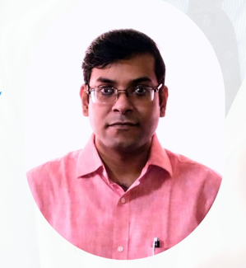
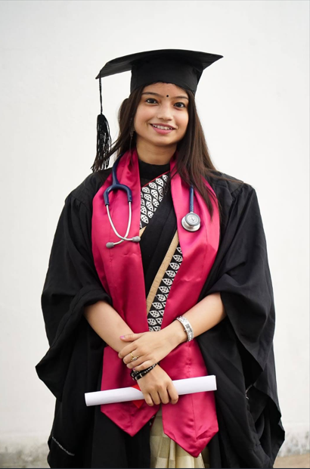
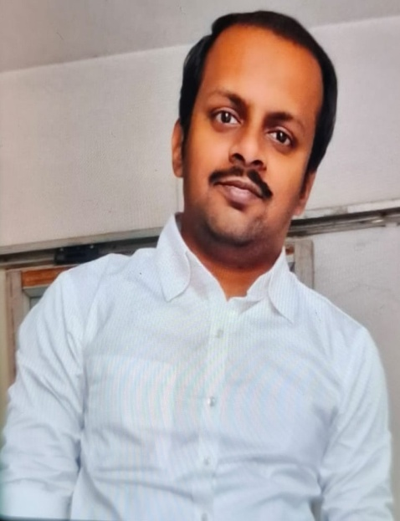
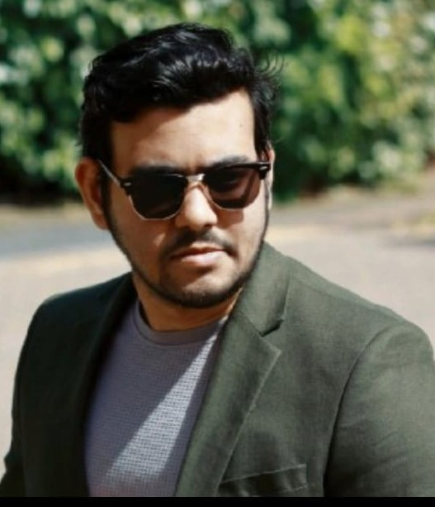
Assisting Doctors(24/7)
Dr. Swagat Saha
MBBS,MDGeneral Medicine), MRCP (UK)
Now attached with Ram Krishna Mission Seva Pratisthan (Sishu Mangal)as assistant professor & RSV Multi Speciality Hospital,Red Cross Society
Dr. Sayantani Chattopadhyay
MBBS (Now working as a RMO in Manipal Hospitals, Dhakuria)
Dr. Debtanu Banerjee
MBBS, MRCP
Now attached with Fortis Hospital (Anandapur)in critical care unit & ILS (Nagerbazaar)in critical care unit
Dr. Sutirtha Bhattacharya
MBBS (General Medicine)

Slide 13
TIED UP HOSPITALS
ARTI MULTI SPECIALITY HOSPITAL,Kamalgazi,E.M.Bypass
IRISH MULTISPECIALITY HOSPITAL,Baghajatin
APEX HOSPITAL,Hiland Park,Santoshpur,E.M.Bypass
RSV MULTISPECIALITY HOSPITAL,Tollygunge
DEVINE MULTISPECIALITY NURSING HOME,Beleghata,phoolbagan,near VIP Road

Slide 14
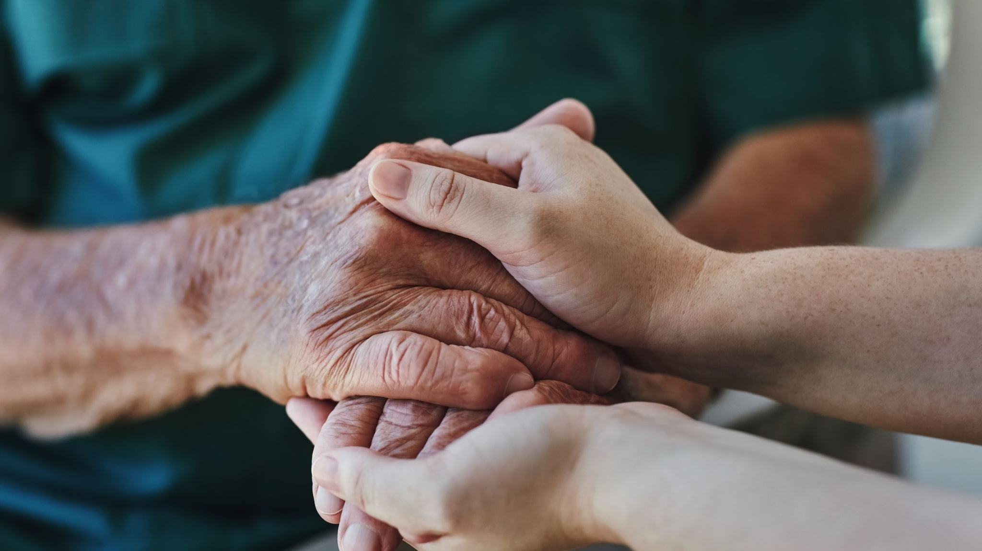
Thanking You
Ayushman Elder Care Services

